Slide 1
An R package for clustering and visualizing ancient DNA signatures
By Hussein Al-Asadi & Kushal Dey

Slide 2
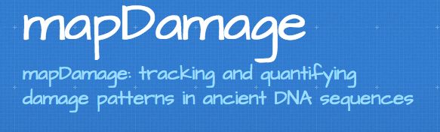
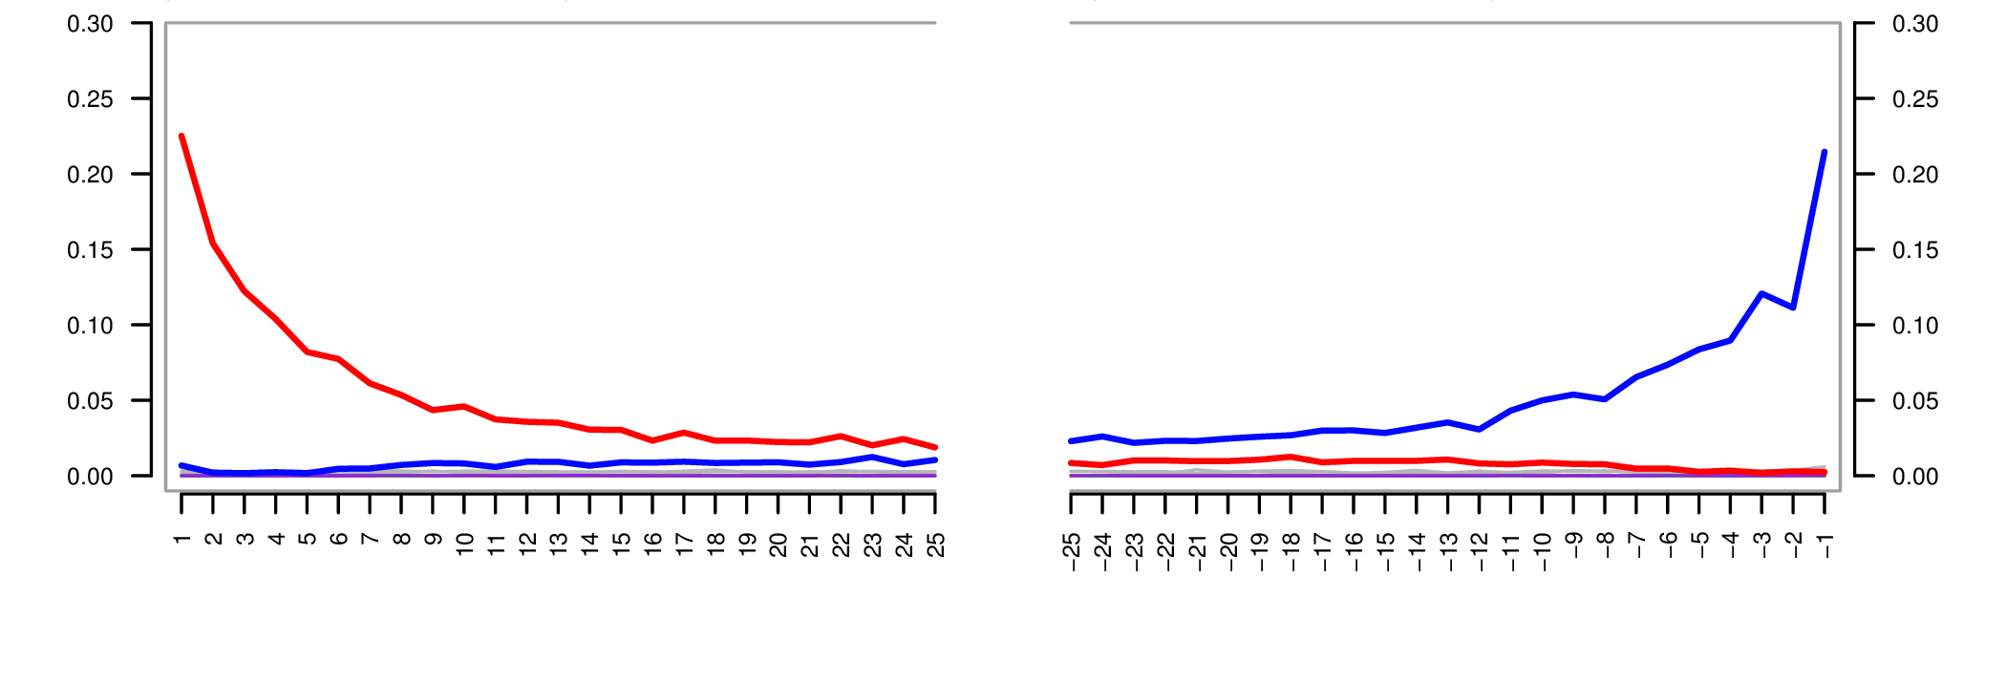
C->T
G->A

Slide 3
Data-set # 1
DiRenzio Lab: 48 Ancients and 7 control samples
Questions:
Do the ancients look “ancient”?
Is there any DNA in the the controls?
If so, is the DNA modern or ancient?

Slide 4
MapDamage on Ancients
CNE1
KS20
Shorter
S30
Steeper

Slide 5
MapDamage on Controls
C->T trend
C->T trend
Notes:
LABEL THE PLOTS

Slide 6
MapDamage on Moderns
HG00097
C->T trend
HG00099

Slide 7
MapDamage on Ancient Sards. (different data-set)
C->T trend

Slide 8
Thoughts…
It’s not clear what is an “ancient” C->T damage profile and what is an “modern” profile?
Difficult to perform comparative analysis
MapDamage is an individual-by-individual analysis
Hard to look at all plots simultaneously
Are we missing other patterns?

Slide 9
High-level overview of
Step 1: Gets “mutational patterns” from BAM files, which are flexible
Step 2: Cluster and visualize samples based on “mutational patterns”.

Slide 10
Step 1: Get mutational patterns from BAM files
Mutational pattern: mutation, flanking bases (we use 2), and position from the end of the read.
Loop through bam file and record the number of all such patterns
Example output for Sample_1
AA(T->A)AA, 0, 50, 7
AA(T->A)AA, 10, 40, 3
GC(C->T)TT, 2, 48, 6

Slide 11
Step 2: Clustering and visualization
STRUCTURE: if K=2, a African-American individual will be mixture of African ancestry and European” ancestry where ancestries are defined by a probability vector on allele frequencies
aRchaic: if K=2, a contaminated individual will be mixture of ancient ancestry and modern ancestry where ancestries are defined by a probability vector on mutational patterns

Slide 12
Graphical overview of

Slide 13
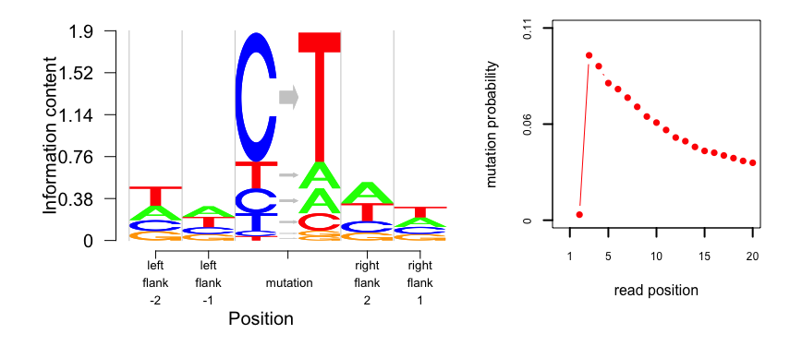
 | Left flank2 | Left flank 1 | Right flank 1 | Right flank 2
A | 0.27 | 0.31 | 0.36 | 0.28
C | 0.20 | 0.20 | 0.19 | 0.21
G | 0.17 | 0.18 | 0.13 | 0.19
T | 0.35 | 0.30 | 0.30 | 0.31
mutations | prob
C -> T | 0.62
C -> A | 0.12
C -> G | 0.03
T -> A | 0.13
T -> G | 0.08
T -> C | 0.02

Slide 14
Applications of
on real data
47 ancients + 7 controls from Di Rienzo lab

Slide 15
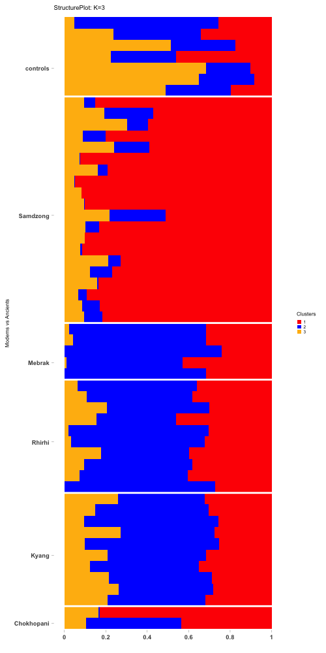
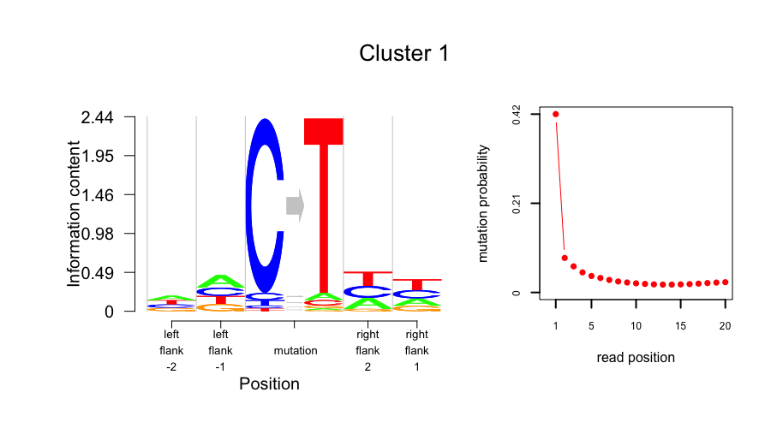
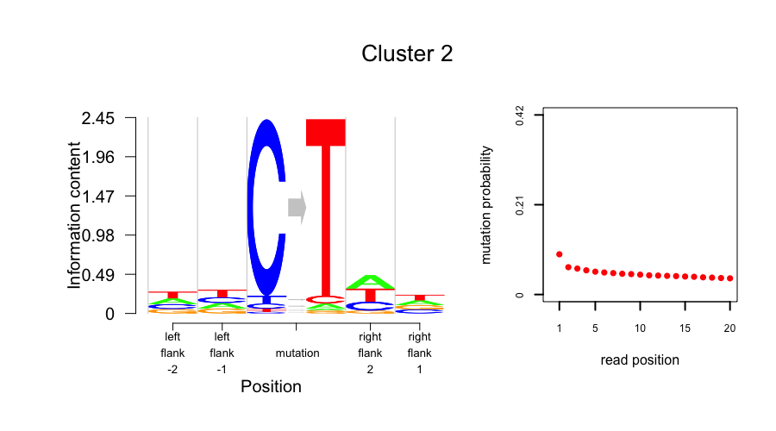
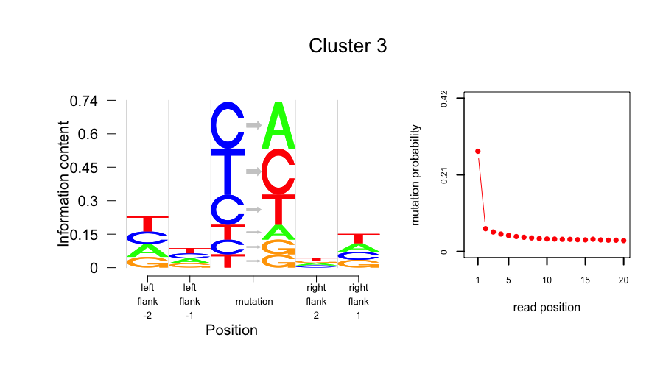
PCRNeg
Libneg3
Libneg2
Libneg1
EXN3
EXN2
EXN1

Slide 16
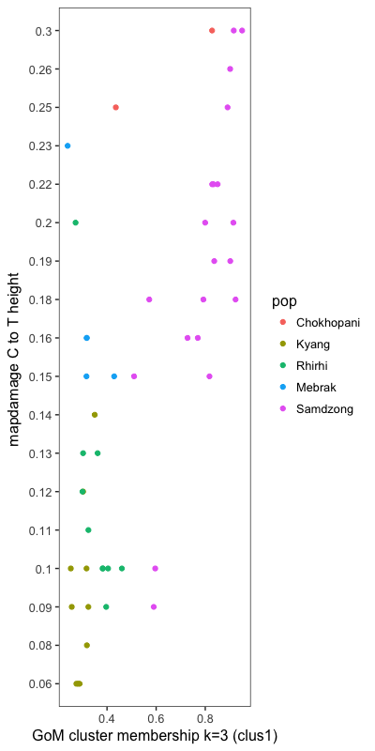
MapDamage on Ancients
CNE1
KS20
S30

Slide 17
Applications of
on real data
47 ancients + 7 controls from Di Rienzo lab +
500 randomly selected 1000 Genome modern samples of European and American ancestry

Slide 18
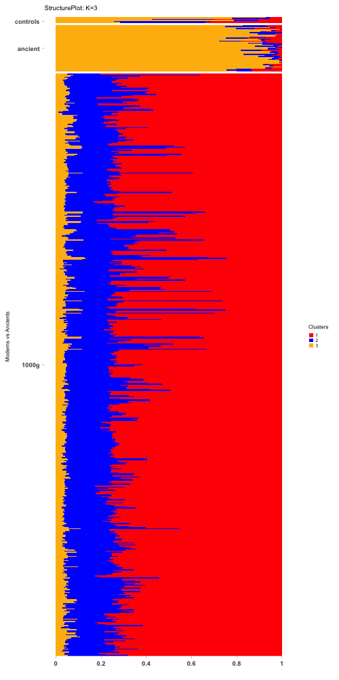
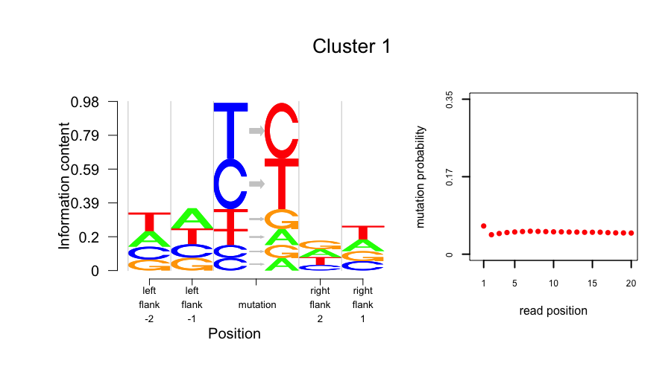
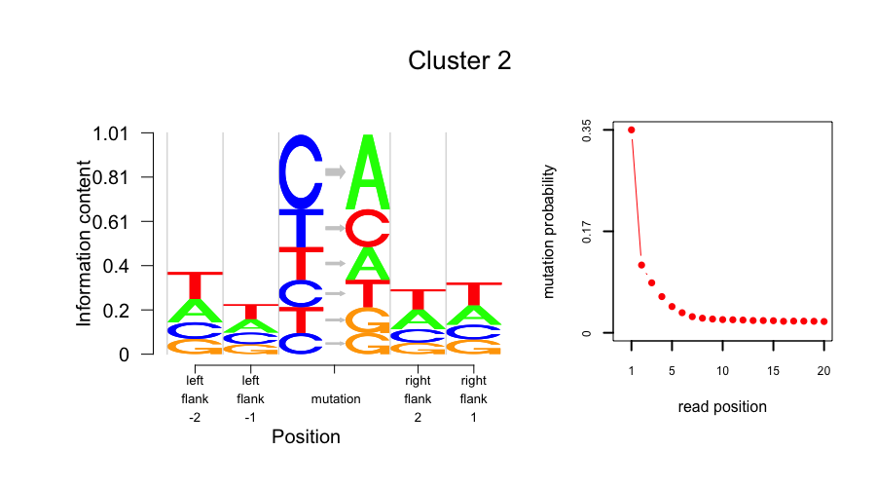
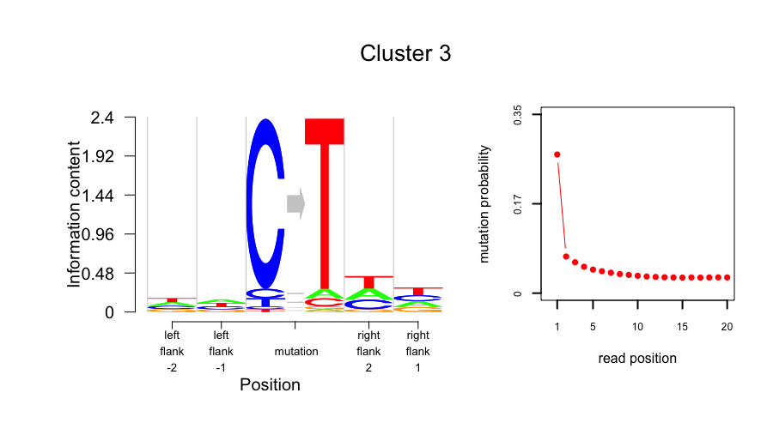

Slide 19
Applications of
on real data
47 ancients + 5 Sherpa samples + 5 ancient Sardinia samples recently collected

Slide 20
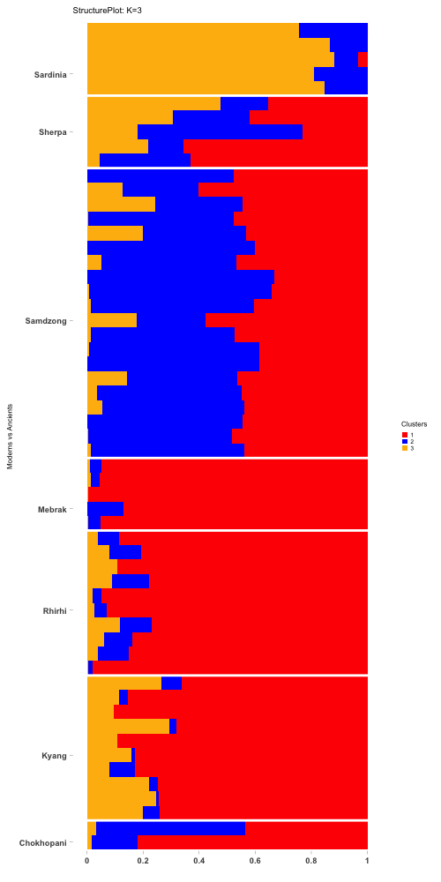
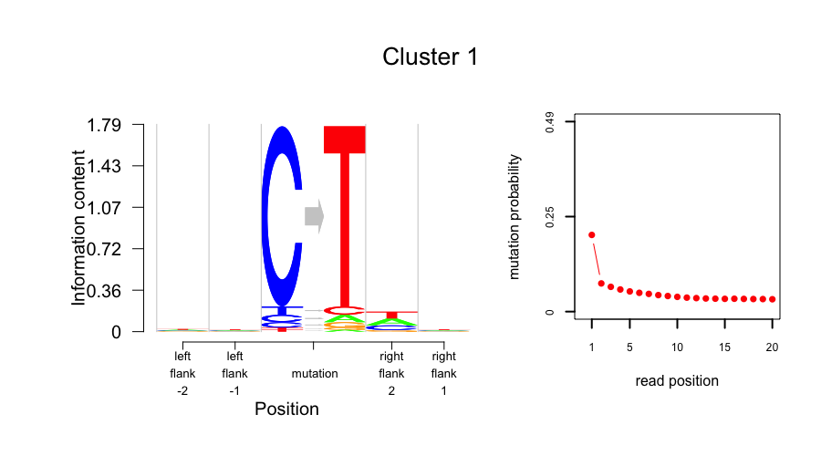
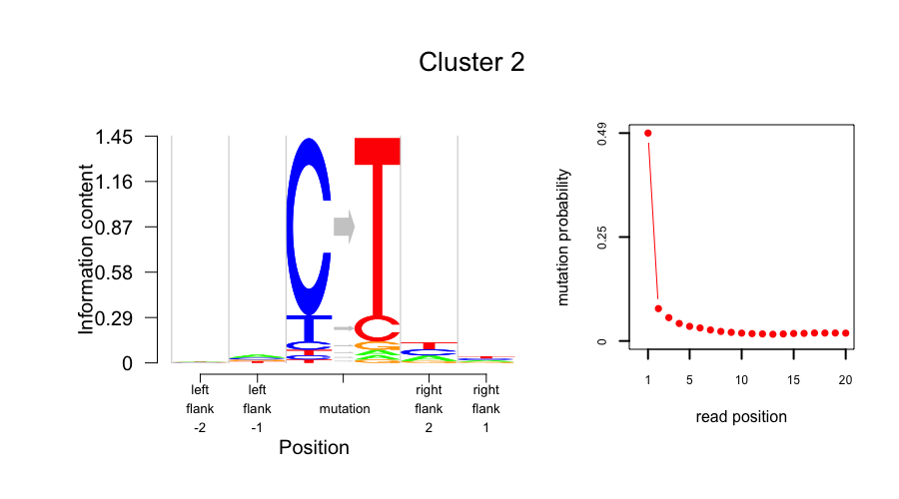
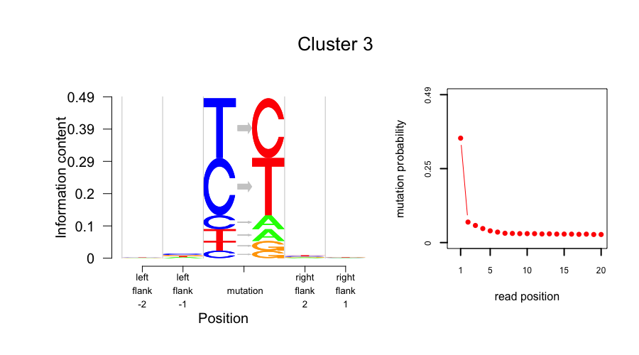

Slide 21
Applications of
on real data
47 ancients + 5 Sherpa samples + 5 ancient Sardinia samples recently collected + 10 HGDP modern samples

Slide 22
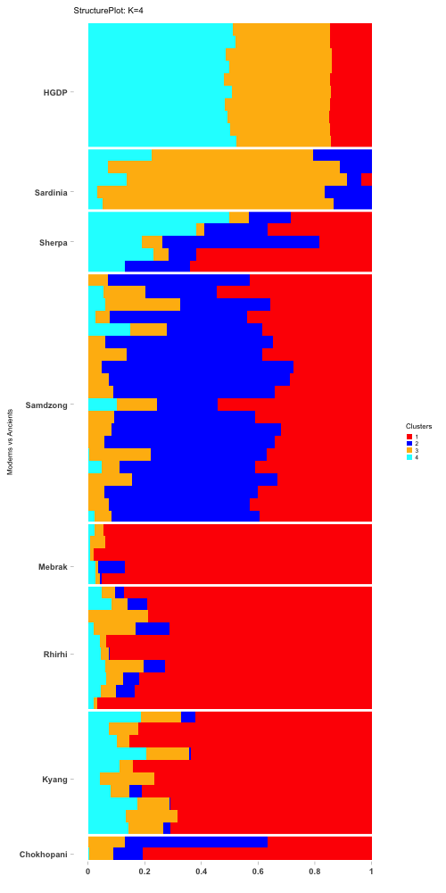
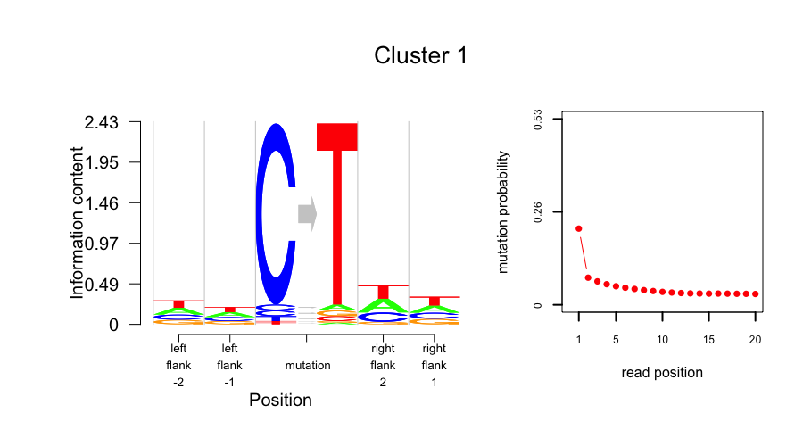
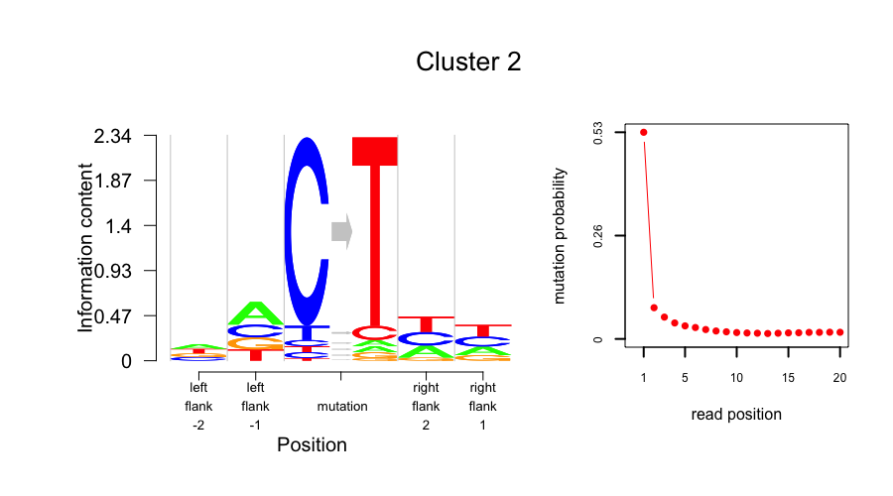
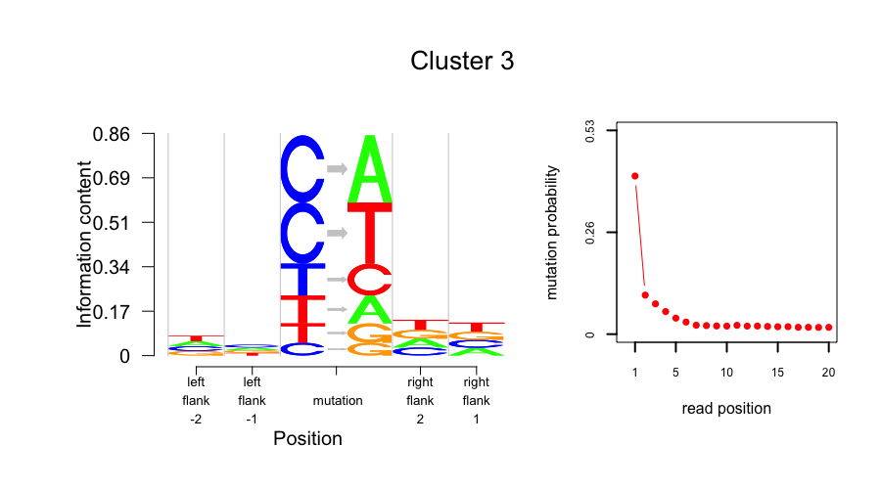
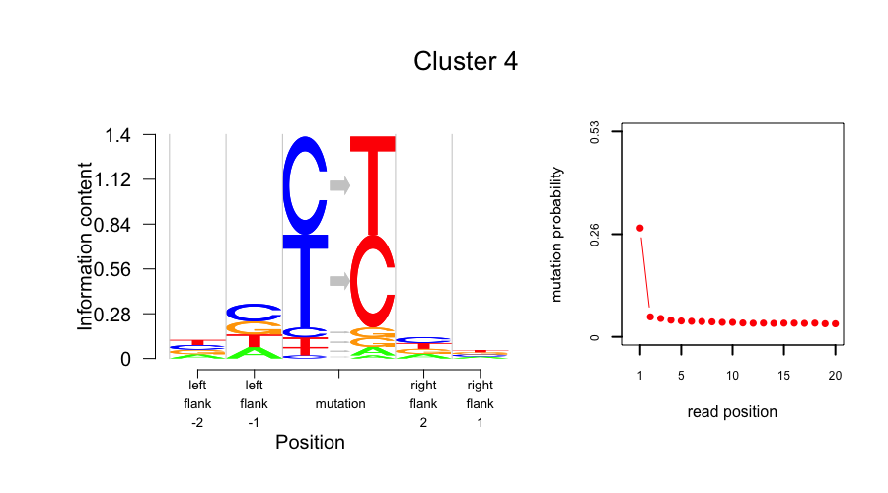

Slide 23
Applications of
on real data
25 ancients + 25 moderns from the ancient data collected by John Lindo (DiRienzo Lab)

Slide 24
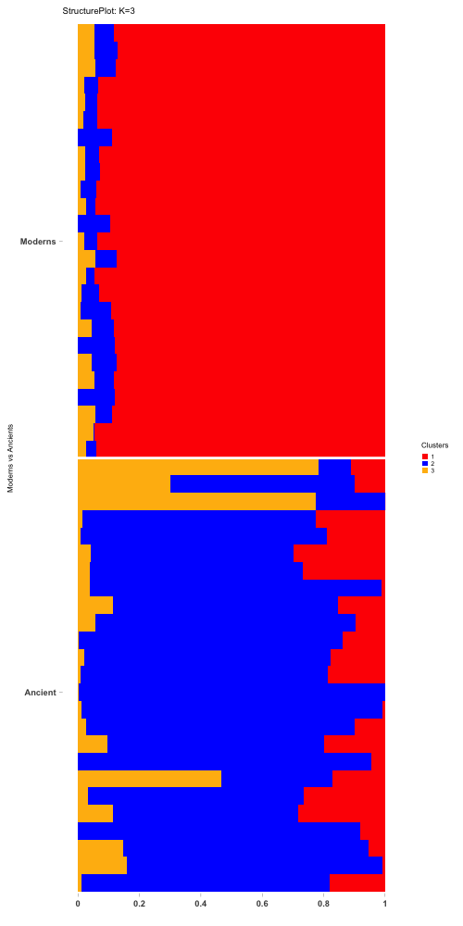
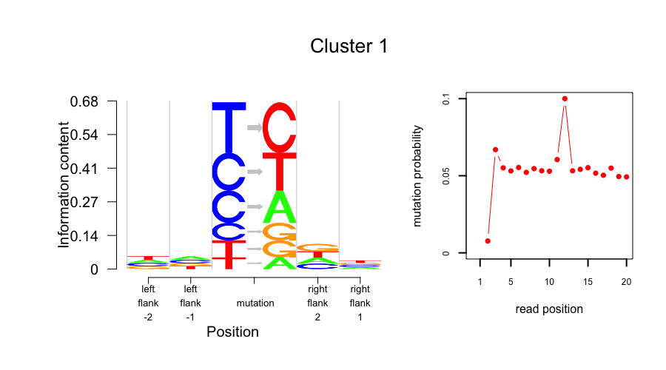
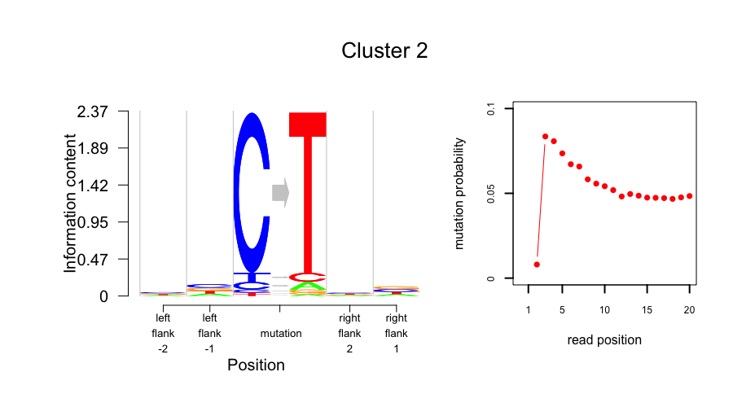
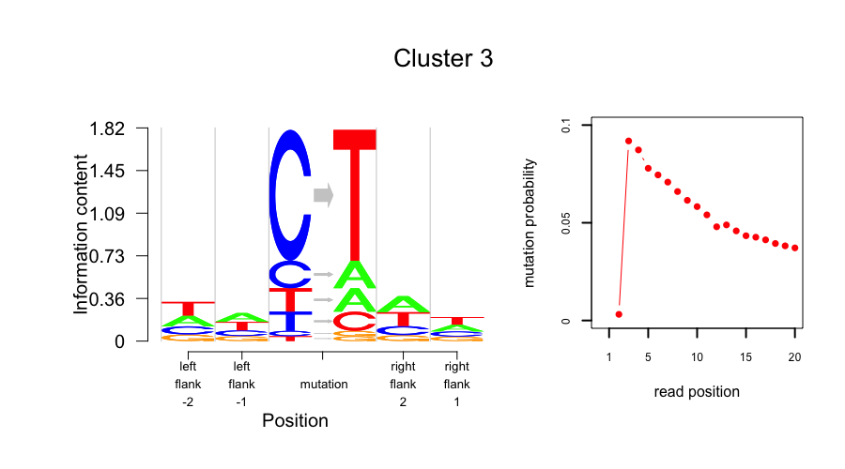

Slide 25
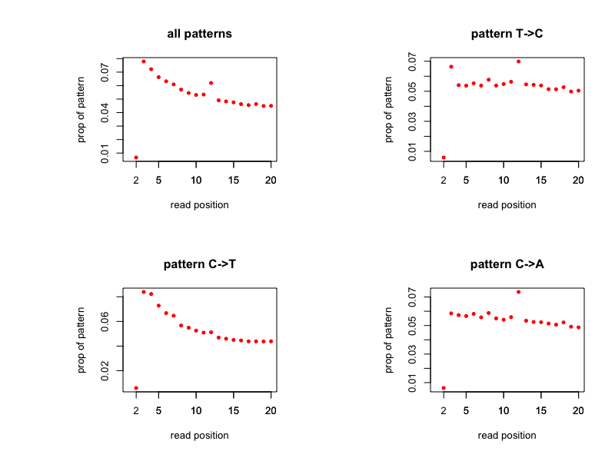

Slide 26
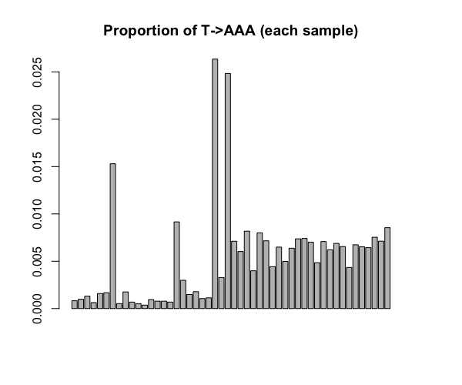
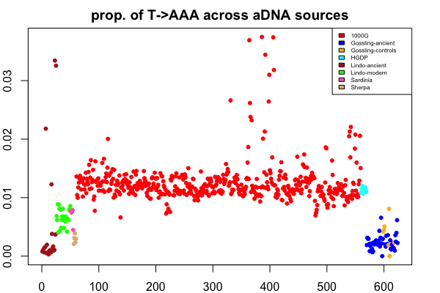
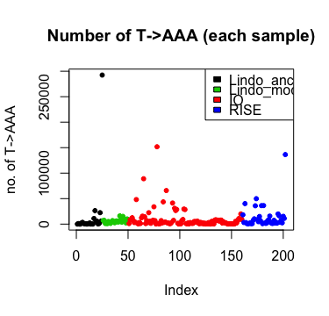
ancient
moderns

Slide 27
Applications of
on real data
Allentoft + Haak et al published ancient data + Di Rienzo data + 10 HGDP modern samples
We show the lab specific effects on mutational patterns.
We remove the C-> T patterns and the read position information and ran the model on remaining mutational patterns.

Slide 28
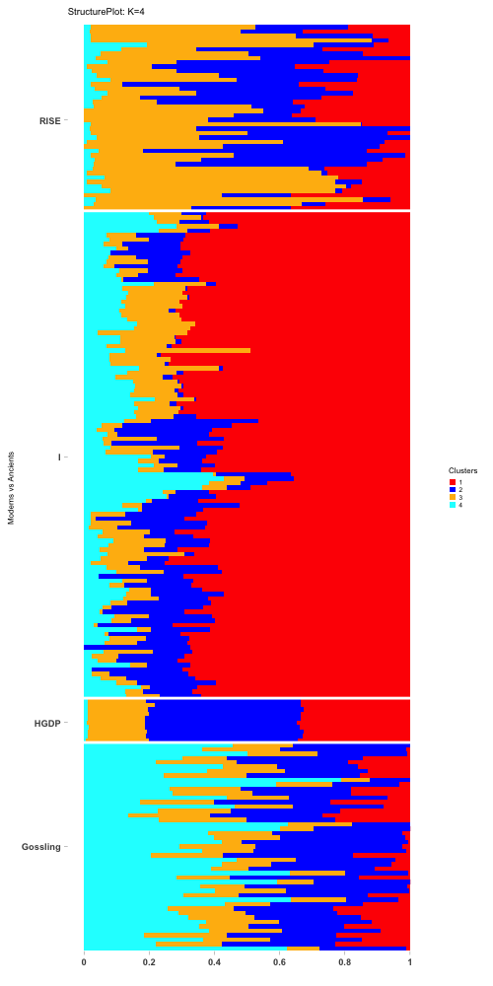
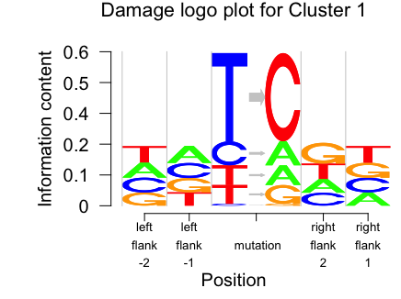
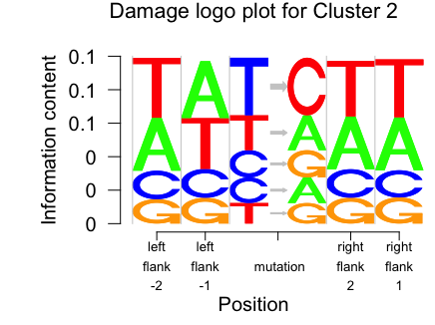
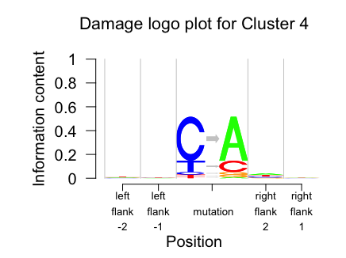
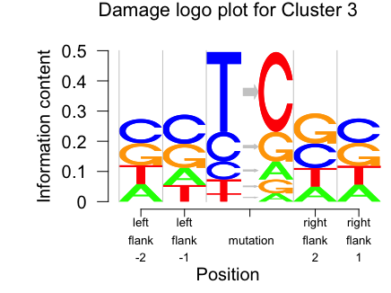

Slide 29
Applications of
on real data
Sherpa + Gossling + HGDP + 100 randomly selected samples from 1000 Genomes + ancient Sardinian data
We focus on only known damage signatures – C->T along with the position of the mutation from end of the read (from position 0 to position 10)

Slide 30
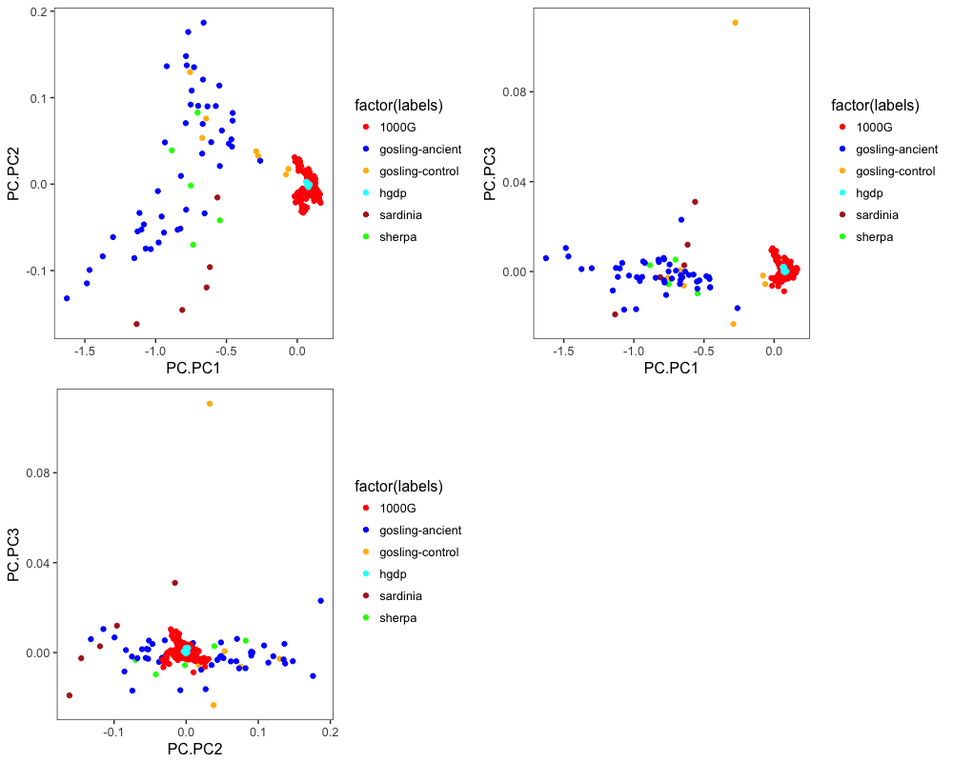

Slide 31
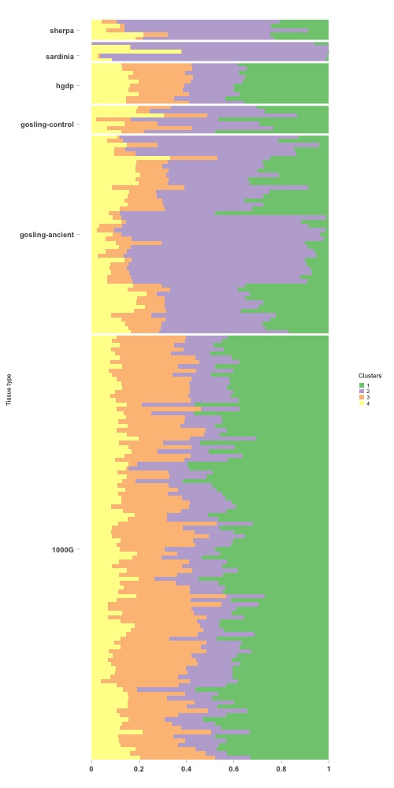
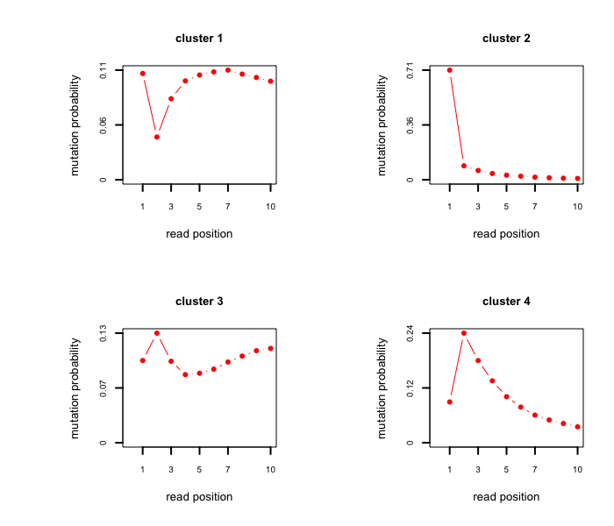

Slide 32
Applications of
In classifying between moderns and ancient samples

Slide 33
Consensus ancient data panel : Sherpa + the Gossling ancient.
Consensus modern data panel: 1000 Genomes + HGDP moderns.
We train the moderns and the ancient panels using the above data and test on the Sardinian ancients and the Gossling controls data.
We apply Support Vector machines for classifying the test samples and generate a probability for each test sample to come from consensus moderns and equivalently, from consensus ancient panels.
For Sardinian samples (total 5), 2 samples were classified as ancients and 3 as moderns.
For Gossling controls data (total 7), 2 were classified stronglt as ancients (EXN3 and Libneg3) and the rest as moderns.

Slide 34
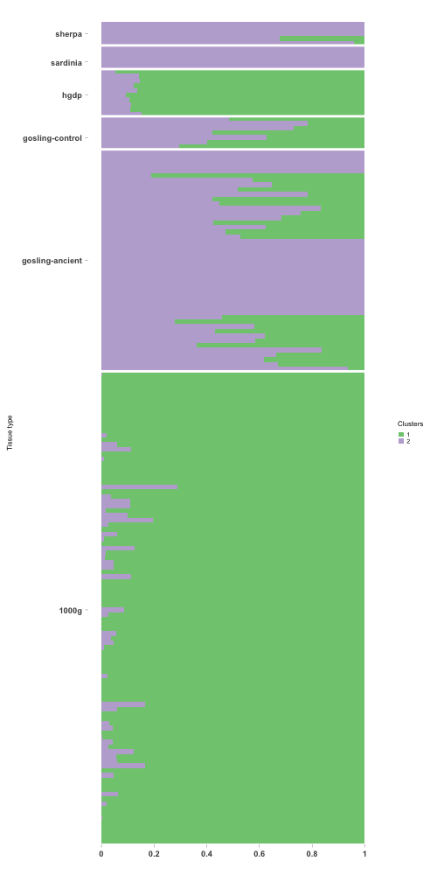
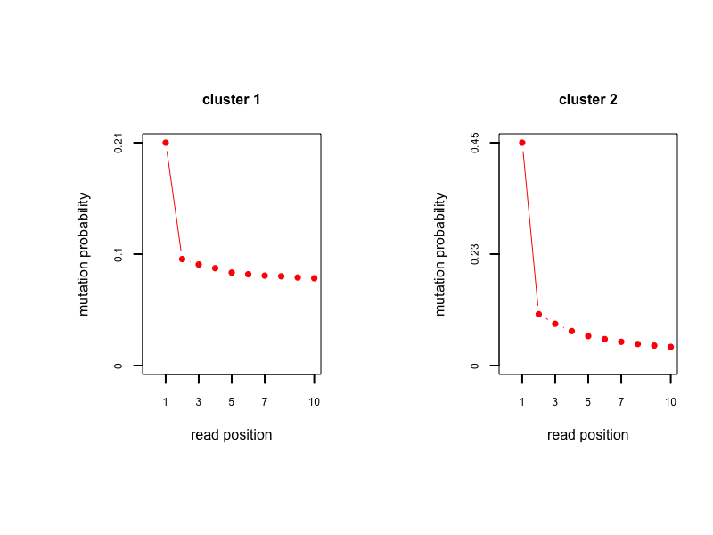
Train: ancient
Test
Train: moderns
Test
Train: ancient
Train: moderns

Slide 35
R package
Developmental version :
https://github.com/kkdey/aRchaic
The codes and the scripts for generating the plots and also additional plots for other values of K can be found at
https://github.com/halasadi/ancient-damage

Slide 36
